Slide 1
Climate Change Trends in the United States
A project by:
Irene, Sebastian, Stephanie and Vinutha

Slide 2

The Problem
Climate change is already happening, and it’s detrimental to human life, too. The worst impacts of climate change could be irreversible by 2030.
Many leaders still aren’t taking it seriously.
Source: https://www.earthday.org/5-terrifying-climate-change-facts-scare-halloween/
Notes:
Change to meme

Slide 3
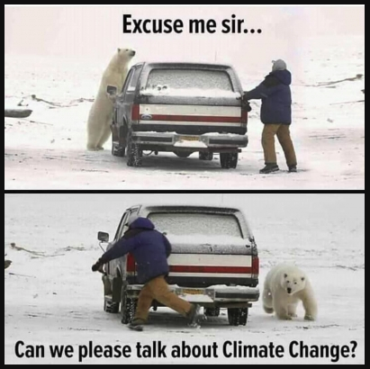
Can we quantify the human impact on Climate Change in the USA?

Slide 4
Rationale and Discovery Questions
Why
Climate Change is well researched topic with good dataset availability.
The US has the population and pollution history to examine trends by region
Questions To Answer
Does human impact affect how States individually experience climate change?
Are there climate change trends evident in temperature and CO2 over time?

Slide 5

Key Findings

Slide 6
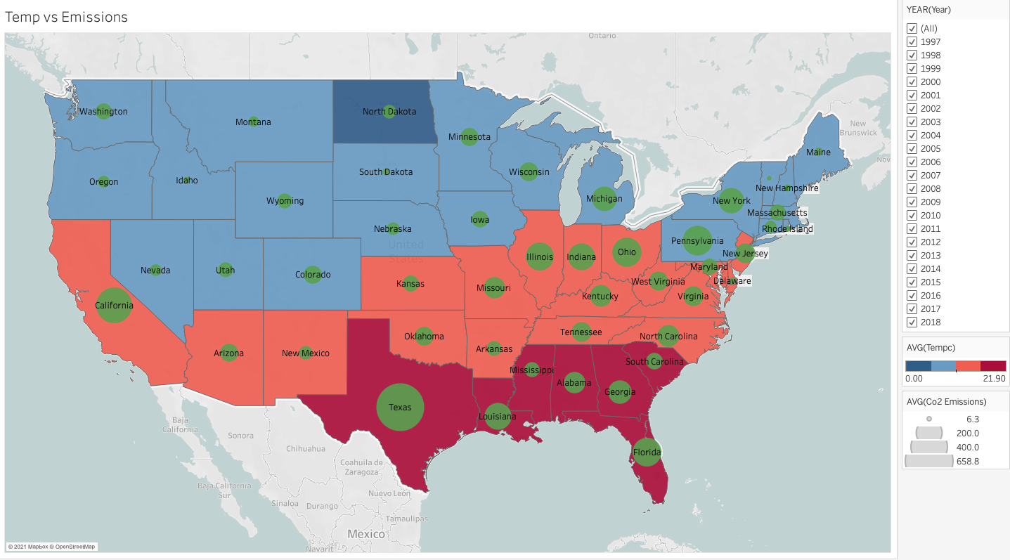
LOCATION, LOCATION, LOCATION
Geographical factors is the key predictor for determining temperature change over time
Notes:
National temp over time - showing state temp

Slide 7
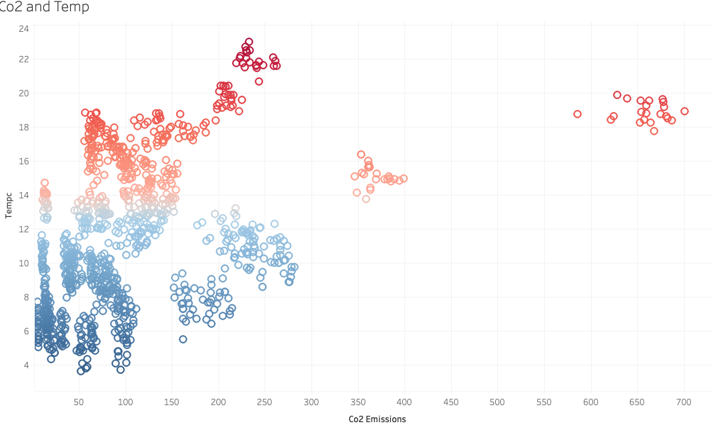
CO2 Emissions
CO2 emissions has a positive correlation with temperature
“Around half of the CO2 emitted since 1750 has been in the last 40 years….”
https://www.wired.co.uk/article/climate-change-facts-2019
Notes:
CO2 vs temperature

Slide 8
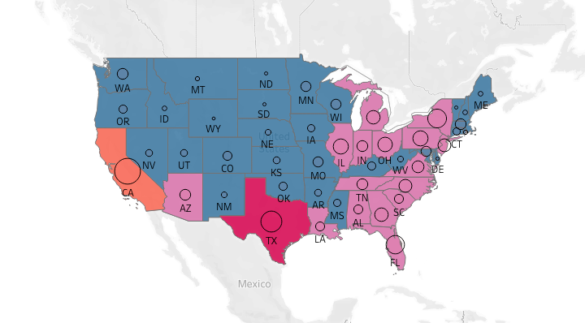
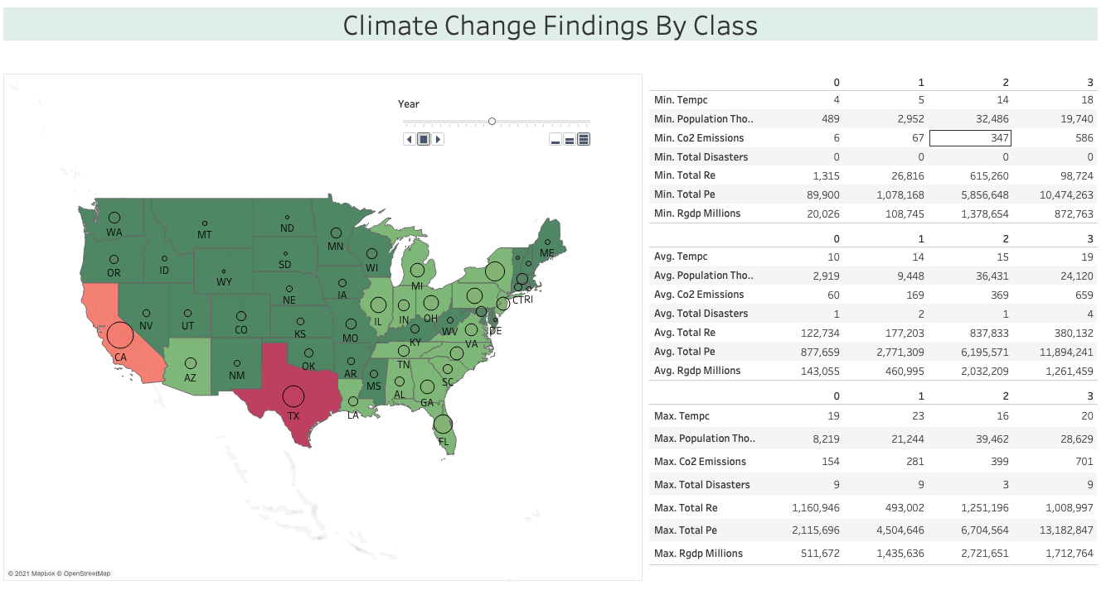
Class/Cluster Analysis
Divided states into 4 clusters based on similar features using PCA analysis

Slide 9
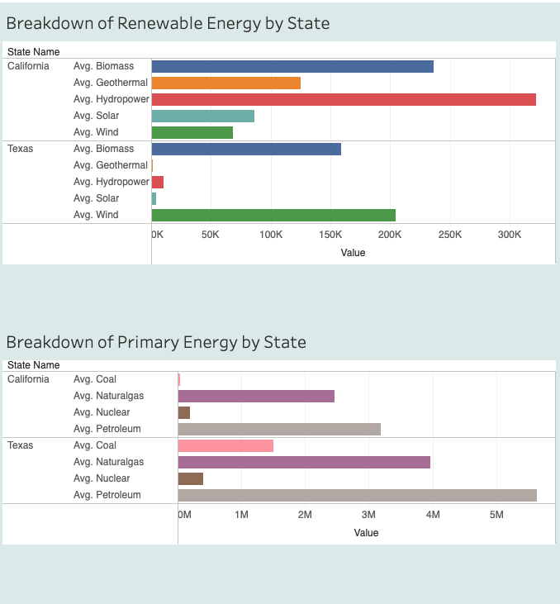
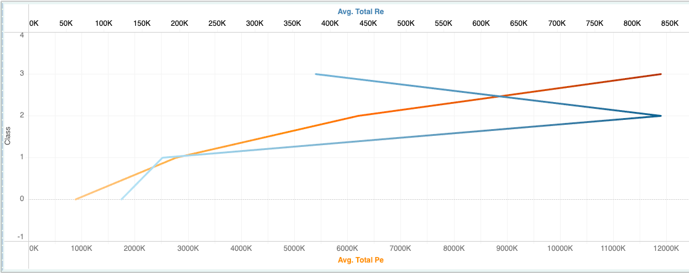
Significant States
California and Texas are their own clusters/class based on CO2 emissions and energy consumption
Notes:
CO2 vs temperature graph add line chart for “good news’

Slide 10
Data Sources
and
Database

Slide 11
Data Sources
Sources
Data.world dataset supplemented with information from Government websites such as:
NOAA -National Oceanic and Atmospheric Association
EIC - Energy Information Association
NCDC- National Centre of Environmental Information
The Washington Post
Questions To Answer
Using these datasets, can we predict temperature or CO2 using human impacts on climate change versus geographical information alone?
Dataset Timeframe : 1997-2018

Slide 12
Database - PostgreSQL
CLIMATE_CHANGE
SQLALCHEMY
ML MODEL SCRIPTS
climate_features_df
SQLALCHEMY
Data Processing Scripts
STATE_US_MASTER - STATE_NAME & ABB
STATE_TEMP - temperature in celsius
STATE_EMISSIONS - CO2_emissions
STATE_RGDP - real GDP in millions
STATE_POPULATION - Population STATE_ENERGY - 4 primary energy, 5 renewable energy
STATE_DISASTERS - 7 disasters
CLIMATE_FEATURES - use JOIN on all tables to get consolidated view table
DATASETS AS .CSV
JOIN
Notes:
Delete and combine with datasources… talk about/visualize different csvs?

Slide 13
Data Exploration

Slide 14
Unsupervised Machine Learning
FEATURES DATAFRAME
TempC with float value of 3.xx to 22.xx - RGDP in millions - Population in thousands
STANDARD SCALER
Standardized or Scaled Data to feed into ML model
Principal Component Analysis PCA
Dimensions reduced to 3 Principal components with best explained_variance_ratio of 71%
ELBOW CURVE
Convincing Elbow bend at K = 4
(range from 3 to 7)
K-MEANS Algorithm
CLIMATE DATA DIVIDED into 4 CLUSTERS AS OUTPUT
Notes:
Add clusters table to talk more about cluster differences

Slide 15
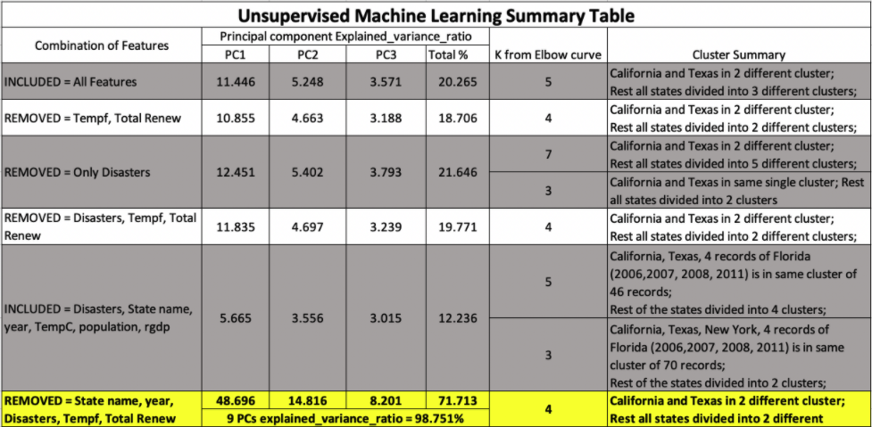
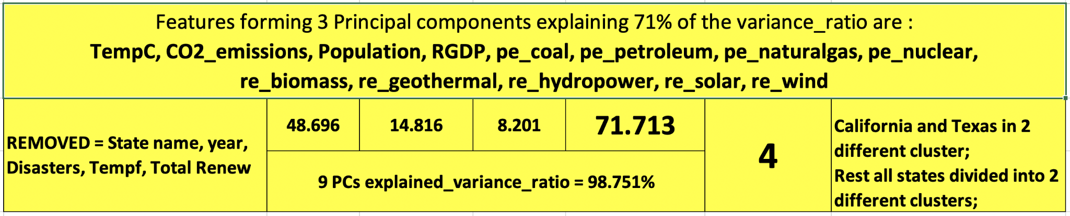
Unsupervised Machine Learning - Feature Combination
Notes:
Add clusters table to talk more about cluster differences

Slide 16
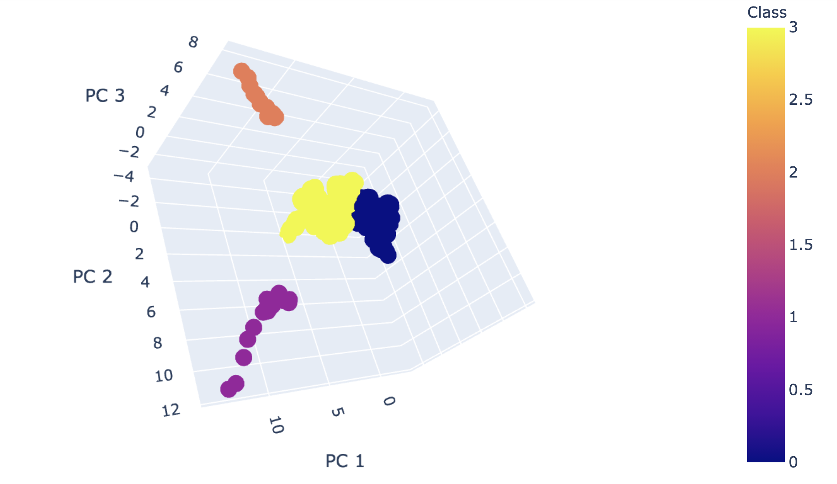
Unsupervised Machine Learning - Clusters
TEXAS
CO2 585-701
17 states
CO2 70-281
Does human impact affect how states individually experience climate change?
Are some states exacerbating climate change through consumption patterns?
32 states
CO2 5-154
CALIFORNIA
CO2 346-400

Slide 17
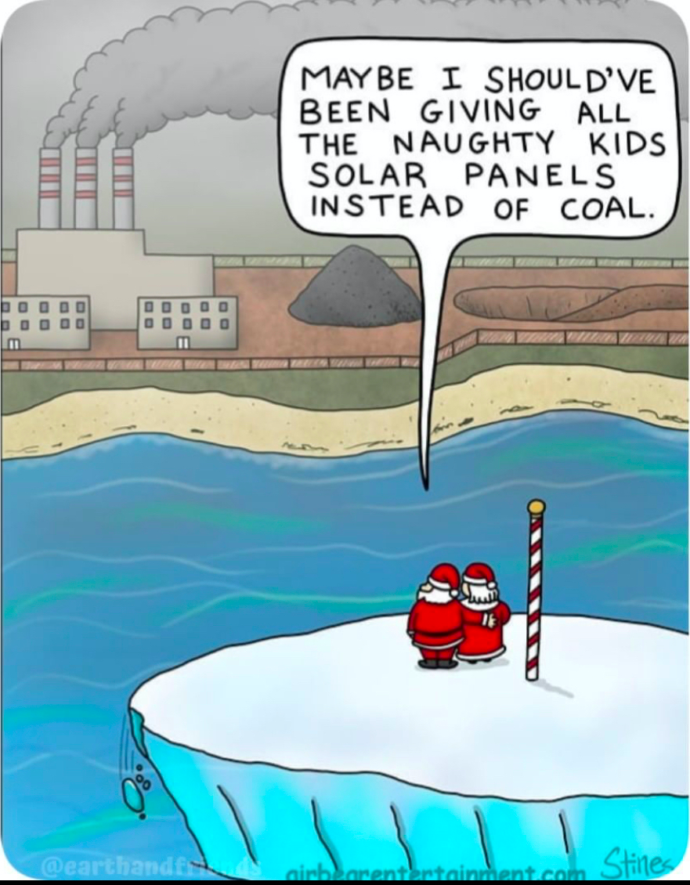

Slide 18
Data Analysis

Slide 19
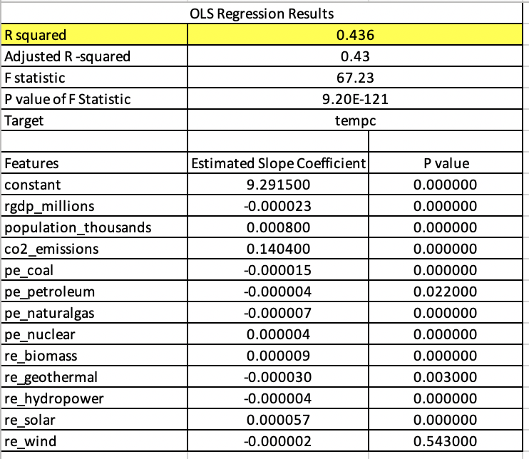
Supervised Machine Learning
Regression Output using untransformed data with temperature as the target variable and Real GDP, Population, CO2 emissions, and Energy Consumption Levels by source as feature variables.
Notes:
Change to table and add predictions graph - for temperature add graph for 97% accuracy

Slide 20
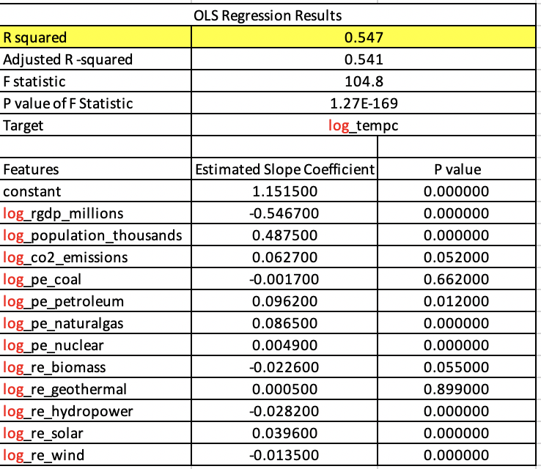
Supervised Machine Learning
Regression Output using log transformed data with temperature as the target variable and Real GDP, Population, CO2 Emissions, and Energy Consumption levels by source as feature variables.
Notes:
Table and graph

Slide 21
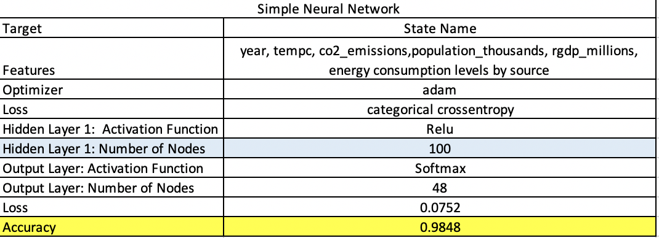
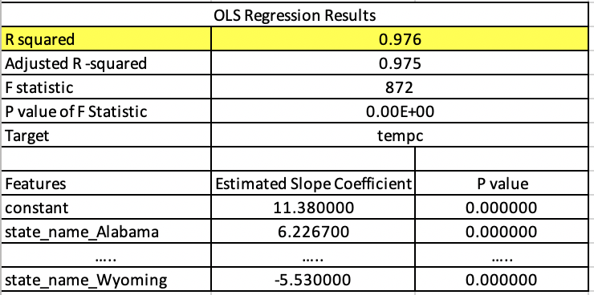
Supervised Machine Learning
Simple Neural Network Predicting State Name using non-state features
Regressing Temperature on State Names
Notes:
Table and graph

Slide 22
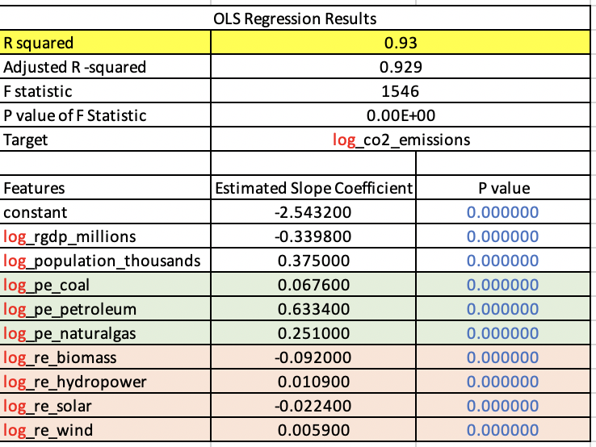
Supervised Machine Learning
Regression Output using log transformed data with CO2 Emissions as the target variable and Real GDP, Population, and only the statistically significant Energy Consumption levels by source as feature variables.

Slide 23
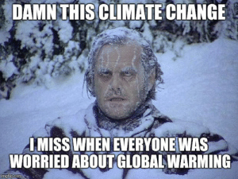

Slide 24
Dashboard

Slide 25
Dashboard
Tools to be used
Tableau
HTML and JavaScript
Combined .csv of all features used in our ML Model
Interactive Elements
Filters by Year, Class, State
Output includes CO2, Energy Consumption and Disasters by State and Class
We chose to work with Tableau as it is a versatile tool used for data visualization. It suits our needs of the project to be able to easily combine geographical (mapped) data with charts of our feature variables.

Slide 26
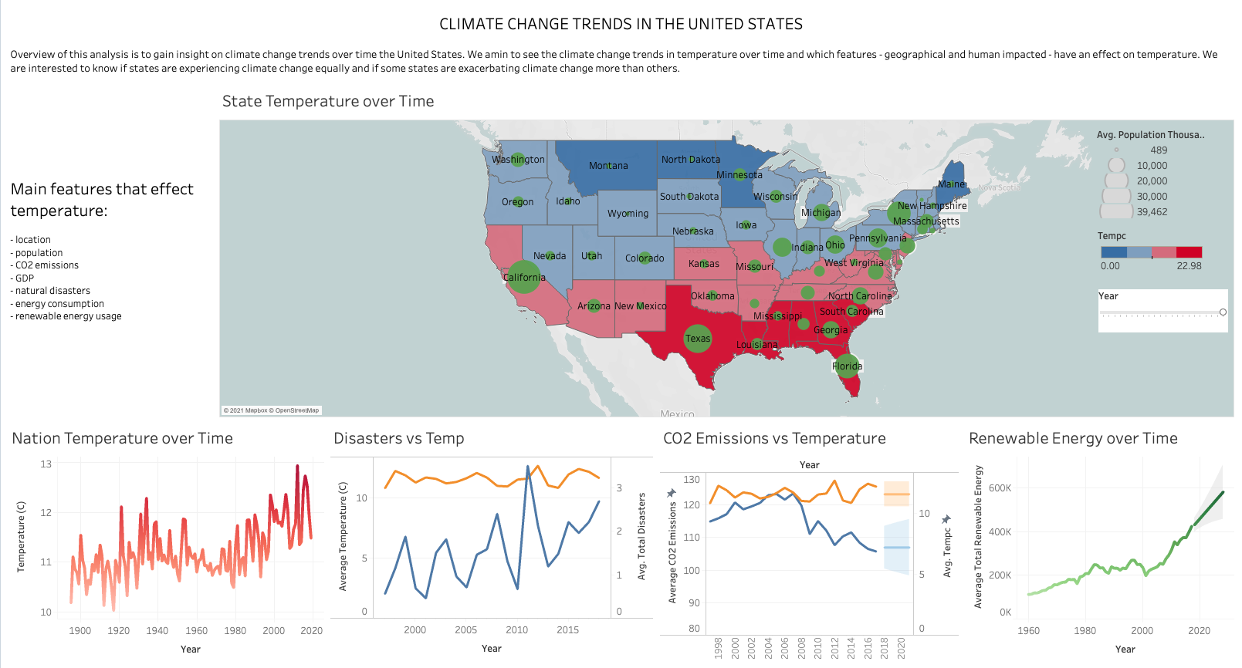
Visit Our Dashboard
https://irenedepacina.github.io/climate_change_webpage/
Notes:
Tableau links

Slide 27
Conclusion

Slide 28

While human impact on temperature is difficult to determine conclusively with our data; human impact on CO2 Emissions can be predicted and impacted through responsible selection of energy sources.

Slide 29
Questions

Slide 30
Check out our Repository
https://github.com/irenedepacina/final_project

Slide 31
Tools and Technologies Used
Tools:
Jupyter Notebook/VSCode
Postgres, PgAdmin
Tableau
Technologies:
Pandas
NumPy
SciKit Learn
Tensorflow
Statsmodels
sqlalchemy
Languages:
Python
SQL
JavaScript/HTML/CSS
Algorithms:
Supervised and Unsupervised Machine Learning
PCA Analysis
Deep Neural Network
Multiple Linear Regression
Notes:
meme?

